Slide 1
Initial Probes Troubleshooting
20 OCT 2020

Slide 2
Background
Probes requested to IDT for 308 fusions
Following design below
Requested on RNA instead of DNA
120 + 0
90 + 30
60 + 60
30 + 90
0 + 120
5’ GENE
3’ GENE
BREAKPOINTS

Slide 3
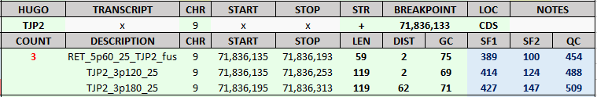
Background
Evaluation of the received probes from BED file
Probes designed for each breakpoint identified
Detailed summary of probe location & coverage for each breakpoint

Slide 4
Issue 1: misunderstood probe design
REQUESTED
RECEIVED
120 + 0
60 + 60
120 + 0
0 + 120
90 + 30
60 + 60
30 + 90
5’ GENE
3’ GENE
0 + 120
~ 70%
5’ GENE
3’ GENE
BREAKPOINTS
120 + 0
120 + 0
60 + 60
0 + 120
0 + 120
WT Probe
5’ GENE
3’ GENE
Fusion Probe
~ 30%

Slide 5
Issue 1: misunderstood probe design
REQUESTED
RECEIVED
120 + 0
60 + 60
120 + 0
0 + 120
90 + 30
60 + 60
30 + 90
5’ GENE
3’ GENE
0 + 120
~ 70%
5’ GENE
3’ GENE
FAVORS WILD-TYPE INSTEAD OF CHIMERIC
BREAKPOINTS
120 + 0
120 + 0
60 + 60
0 + 120
0 + 120
WT Probe
5’ GENE
3’ GENE
Fusion Probe
~ 30%

Slide 6
Issue 1: misunderstood probe design
REQUESTED
RECEIVED
120 + 0
60 + 60
120 + 0
0 + 120
90 + 30
60 + 60
30 + 90
5’ GENE
3’ GENE
0 + 120
~ 70%
5’ GENE
3’ GENE
BREAKPOINTS
120 + 0
120 + 0
60 + 60
0 + 120
0 + 120
WT Probe
5’ GENE
3’ GENE
Fusion Probe
~ 30%

Slide 7
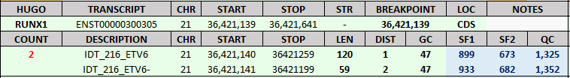
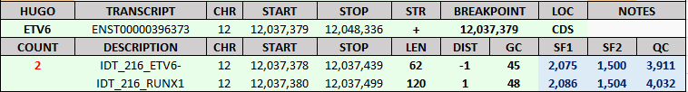
5’ GENE
3’ GENE
120 + 0
60 + 60
0 + 120
5’ GENE
3’ GENE

Slide 8
5’ GENE
3’ GENE
120 + 0
60 + 60
0 + 120
5’ GENE
3’ GENE

Slide 9
5’ GENE
3’ GENE
120 + 0
60 + 60
0 + 120
5’ GENE
3’ GENE

Slide 10
5’ GENE
3’ GENE
120 + 0
60 + 60
0 + 120
5’ GENE
3’ GENE

Slide 11
Issue 1: misunderstood probe design
REQUESTED
RECEIVED
120 + 0
60 + 60
120 + 0
0 + 120
90 + 30
60 + 60
30 + 90
5’ GENE
3’ GENE
0 + 120
~ 70%
5’ GENE
3’ GENE
BREAKPOINTS
120 + 0
120 + 0
60 + 60
0 + 120
0 + 120
WT Probe
5’ GENE
3’ GENE
Fusion Probe
~ 30%

Slide 12
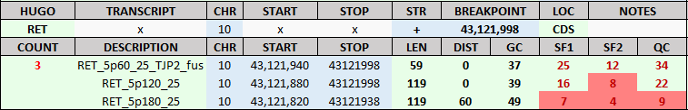
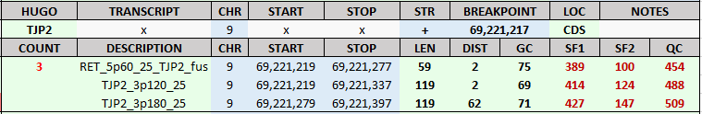
5’ GENE
3’ GENE
ONLY 1 CHIMERIC PROBE vs 4 WILD-TYPE
120 + 0
120 + 0
60 + 60
0 + 120
0 + 120
5’ GENE
3’ GENE

Slide 13
5’ GENE
3’ GENE
120 + 0
120 + 0
60 + 60
0 + 120
0 + 120
5’ GENE
3’ GENE

Slide 14
5’ GENE
3’ GENE
120 + 0
120 + 0
60 + 60
0 + 120
0 + 120
5’ GENE
3’ GENE

Slide 15
5’ GENE
3’ GENE
120 + 0
120 + 0
60 + 60
0 + 120
0 + 120
5’ GENE
3’ GENE

Slide 16
5’ GENE
3’ GENE
120 + 0
120 + 0
60 + 60
0 + 120
0 + 120
5’ GENE
3’ GENE

Slide 17
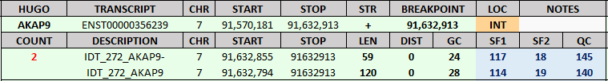
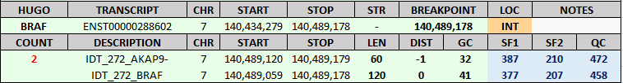
Issue 2: probes not designed on RNA
~ 20% probes designed in intronic regions
+ short exons extended using DNA

Slide 18
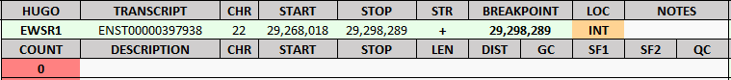
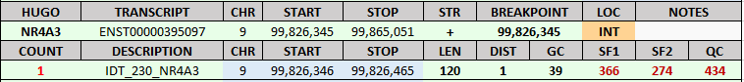
Issue 3: unexplained variations
No probes for a few breakpoints
Sometimes only one probe

Slide 19
New Probes
Probe sequences extracted in-house for 1600+ fusions
Provided to IDT for synthesis
100% designed on RNA
Following initially wanted design
120 + 0
90 + 30
60 + 60
30 + 90
0 + 120
5’ GENE
3’ GENE
BREAKPOINTS

